Slide 1
Software Evolution
Software Configuration Management Tools (SCM)

Slide 2
Software Configuration Management Tools (SCM)
In Software Engineering Software Configuration Management is the task of tracking and controlling changes in the software part of the larger disciplinary field of Configuration Management.
The SCM practices include version controls in the establishment of baselines. If something goes wrong, SCM can determine what was changed and who changed it.

Slide 3
SCM Features
Enforcement: With enforcement feature execution daily, ensures that the system is configured to the desired state.
Cooperating Enablement: This feature helps to make the change configuration throughout the infrastructure with one change.

Slide 4
SCM Features
Version Control Friendly: With this feature, the user can take their choice of version for their work.
Enable Change Control Processes: As Software Configuration Management tools are version control and textual friendly we can make changes in code. Changes can be made as a merge request and send for review.

Slide 5
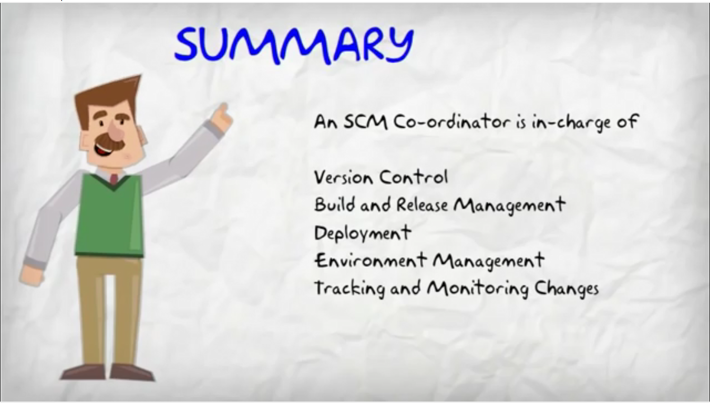

Slide 6
SCM Examples
SolarWinds
CFEngine Configuration Tool
Azure DevOps

Slide 7
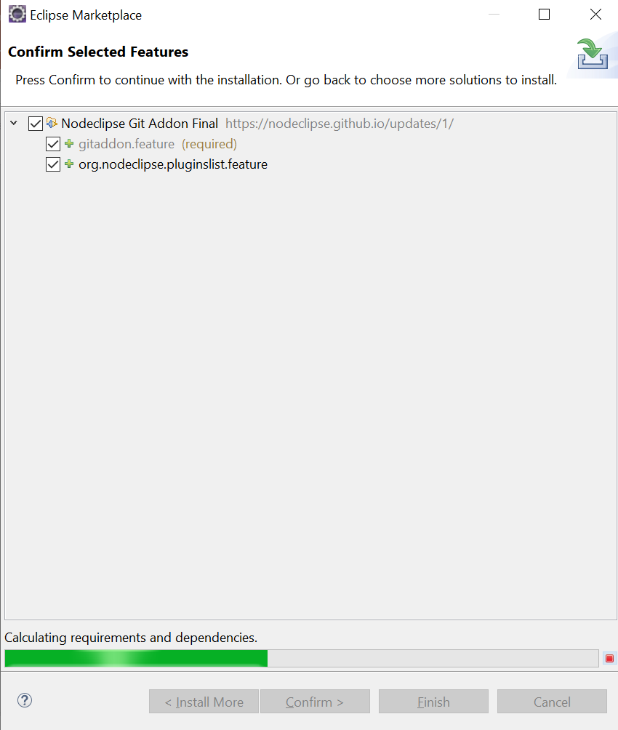
Integrate Git Addon with Eclipse
Open Eclipse marketplace and search for “Git”
Install Nodeclipse Git Addon

Slide 8
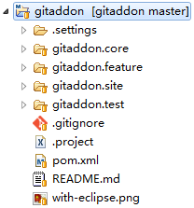
Integrate Git Addon with Eclipse

Slide 9
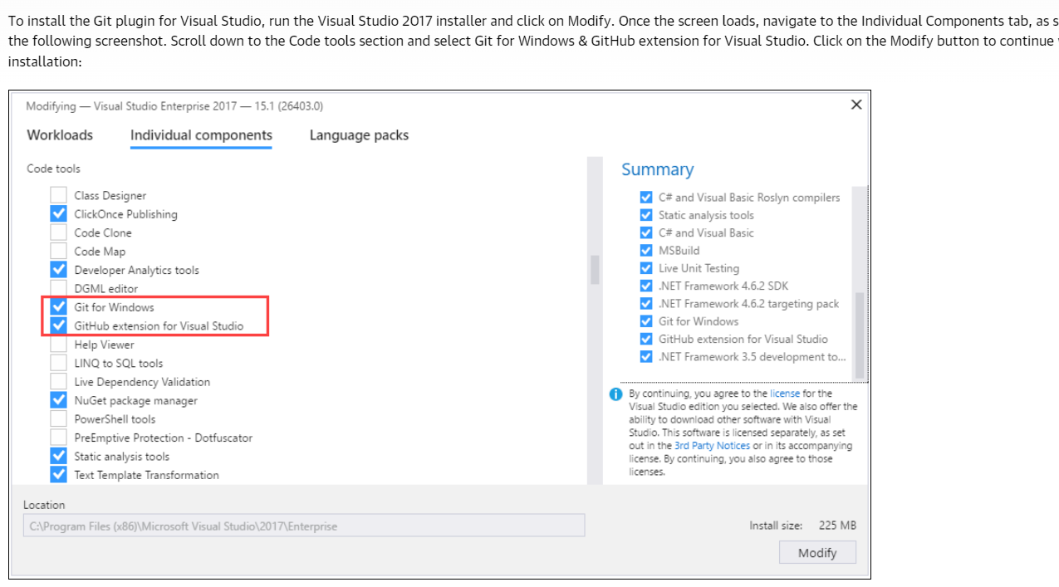
Installing Git for Visual Studio

Slide 10
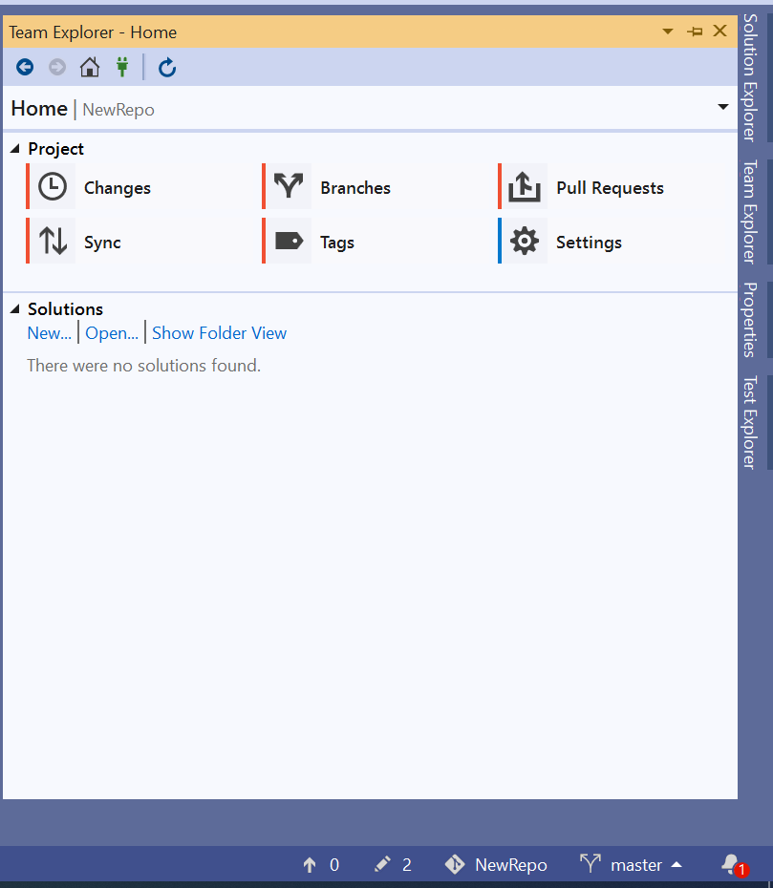

Installing Git for Visual Studio

Slide 11
References
https://www.youtube.com/watch?v=AaHaLjuzUm8
https://www.softwaretestinghelp.com/top-5-software-configuration-management-tools/
https://marketplace.eclipse.org/content/nodeclipse-git-addon
https://www.oreilly.com/library/view/mastering-visual-studio/9781787281905/61432953-a0b3-4b16-b1fb-2636f7271582.xhtml

Slide 12
Questions

